Slide 1
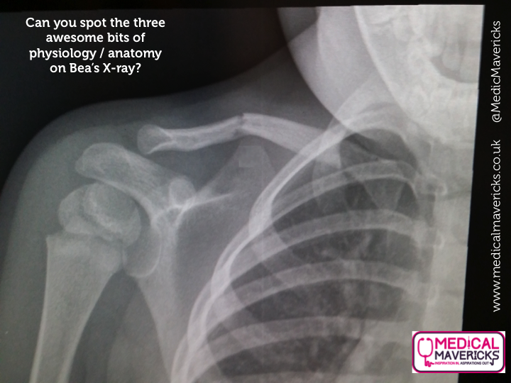

Slide 2
You can see a growth plate at the top of her humerus bone!

Slide 3
You can see here adult teeth underneath her milk teeth! They sit in her jaw until they’re ready to push the ones above out!

Slide 4
The grainy area around her ribs is actually her lungs! This is completely normal. In unhealthy lungs, the graininess is more severe!

Slide 5
BONUS!
You can see the different layers of tissue in her arm too!
You have the skin and adipose (fatty) tissue, followed by the denser muscle tissue.

