Slide 1
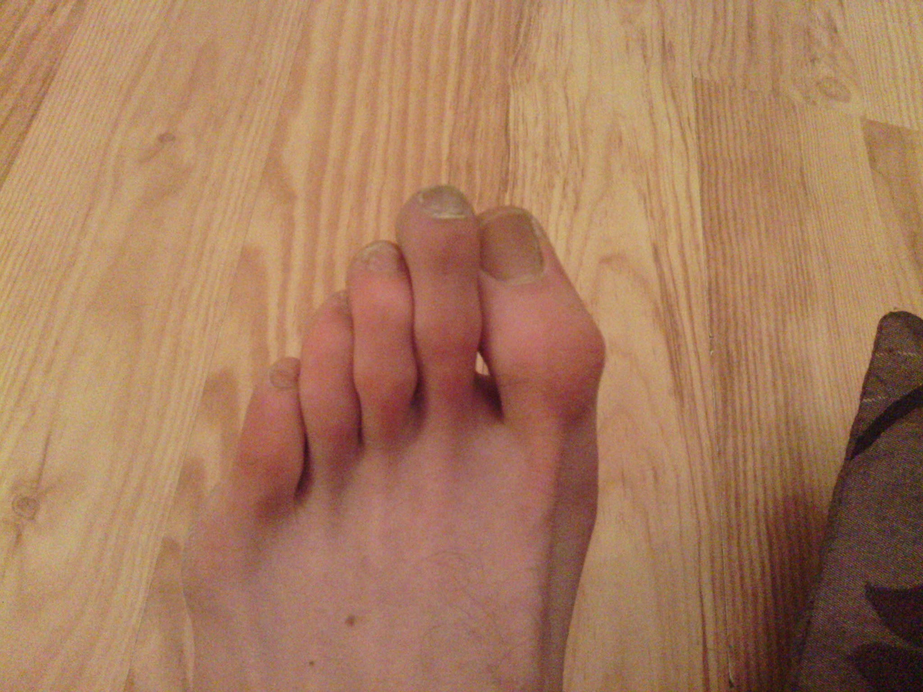
Tom’s big toe is pointing the wrong way!

Slide 2
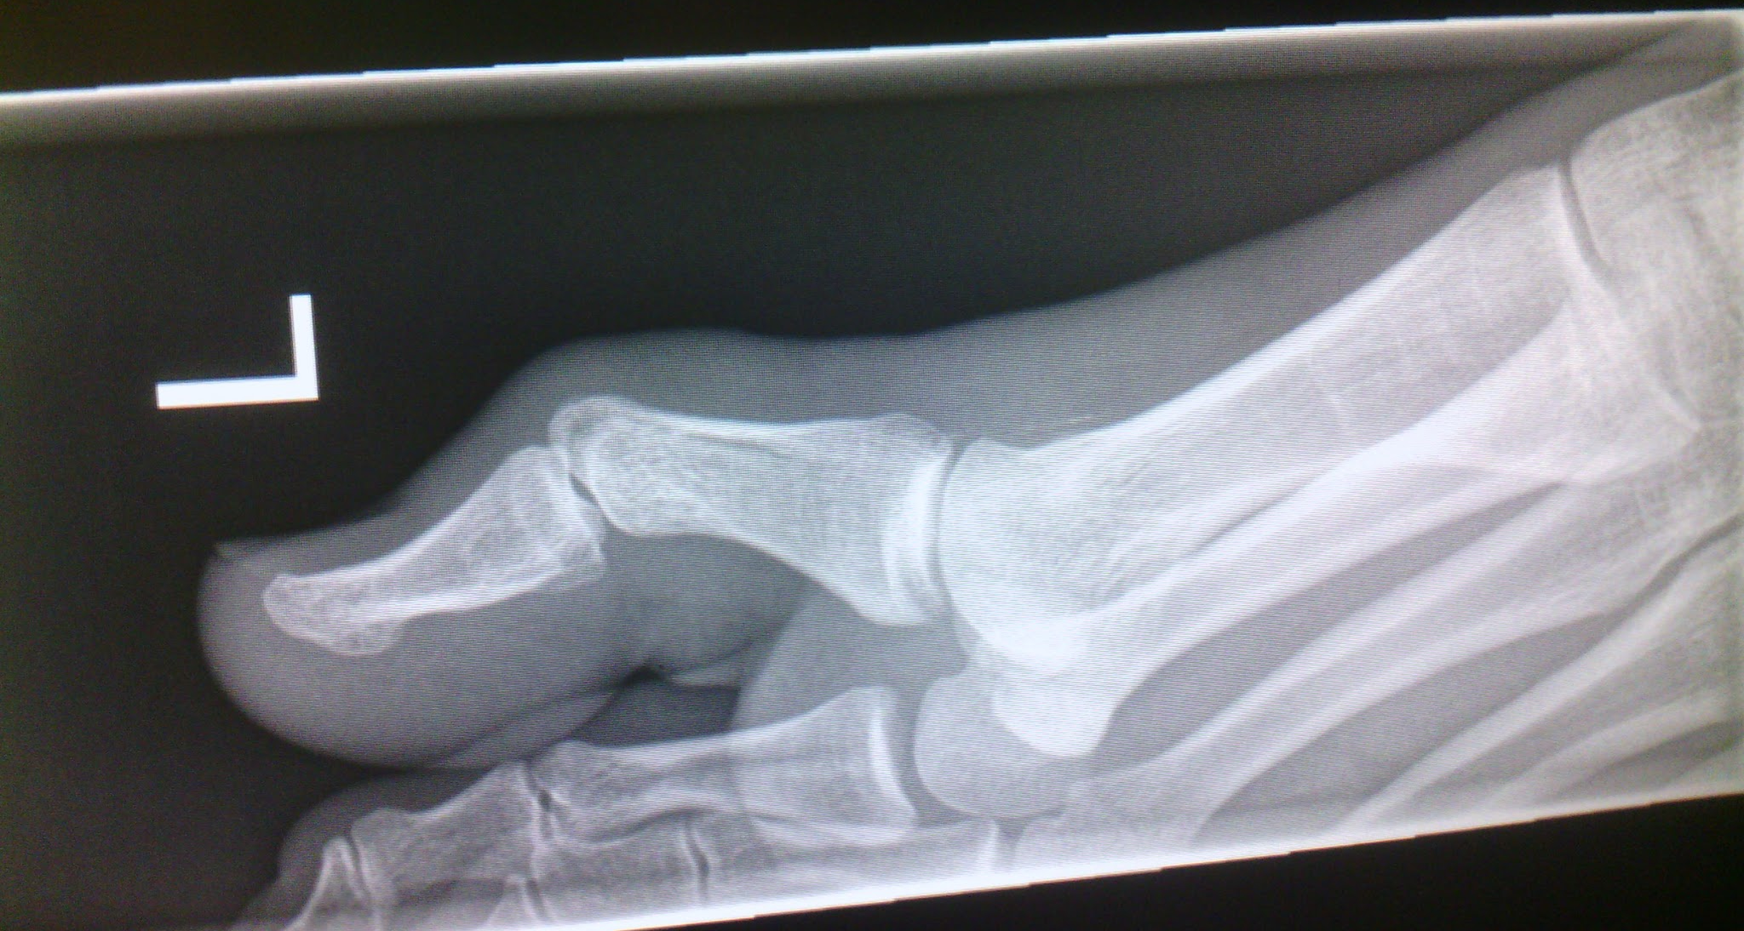
Tom’s final bone (or phalange) in his big toe is clearly not in the right place!

