Slide 1


Slide 2

How many different careers
are there in the NHS?
A: 45
B: 270
C: 350

Slide 3
How many different careers are there in the NHS?
A: 45
B: 270
C: 350

Slide 4
What % of the 350 careers are medical / clinical based roles?
Eg: Doctor, nurse, lab scientist?
A: 37%
B: 52%
C: 85%

Slide 5
What % of the 350 careers are medical / clinical based roles?
Eg: Doctor, nurse, lab scientist?
A: 37%
B: 52%
C: 85%

Slide 6
Clinical
Non Clinical
Caterers
HR
Admin
Records Clerks
Doctors
Radiography
Podiatrist
Pathology
Drivers
Architects
Maintenance
Biomedical Science
Histology
Nurses
Engineers
Business Managers
Electricians
Nuclear Medicine
Oncology
Occupational Health
Legal
Porters
Data Manager
Finance
Dentist
Medical Research
Physio
Chaplain
Medical Secretary
Plumbers
Perfusion Science
Surgical Teams
Midwife
Health & Safety
Cleaners / Decontamination

Slide 7
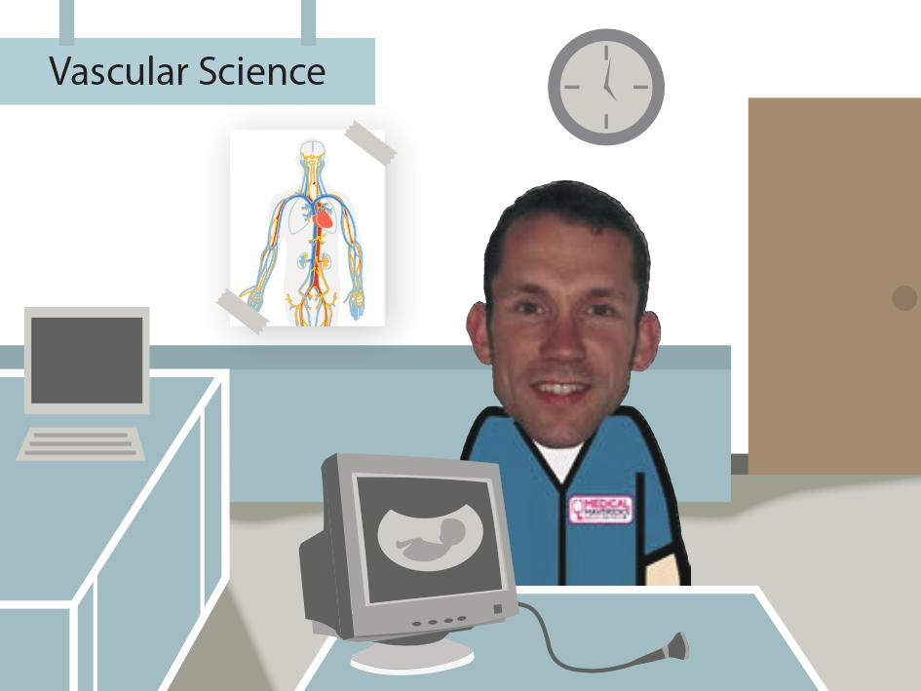

Slide 8
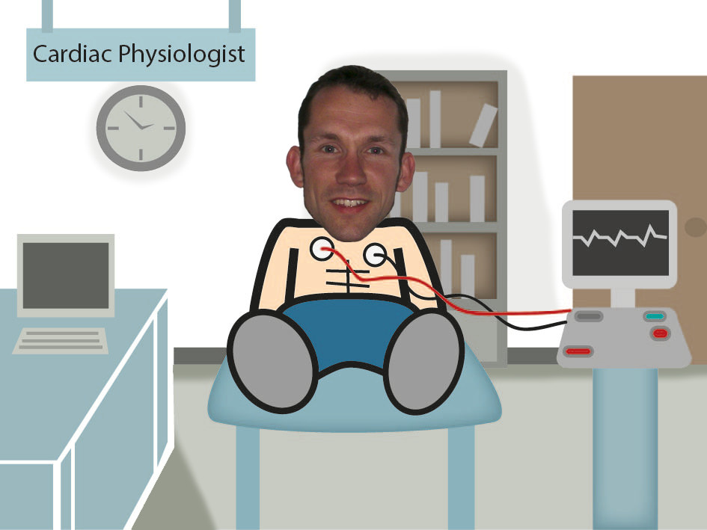

Slide 9
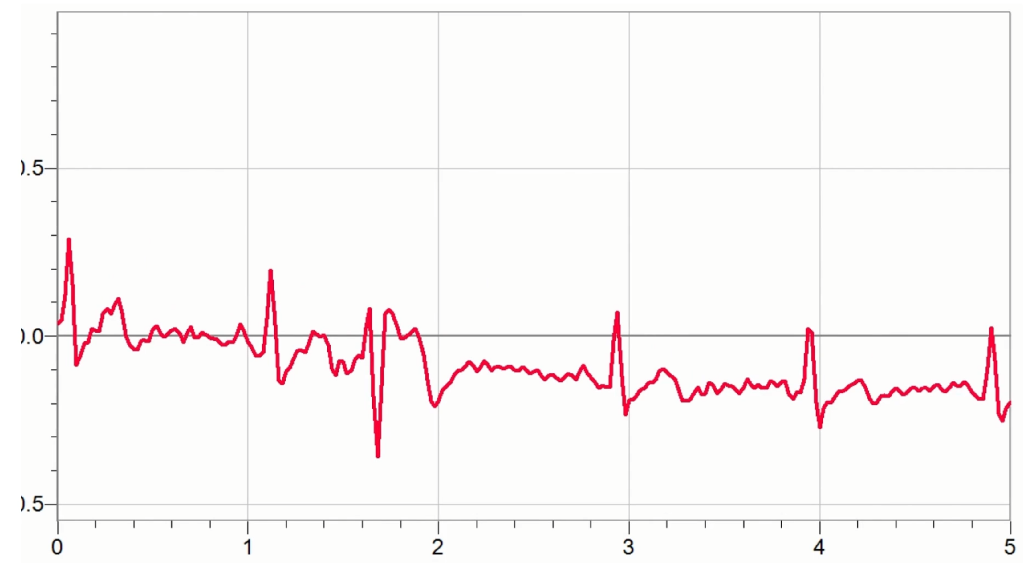

Arrhythmia

Slide 10
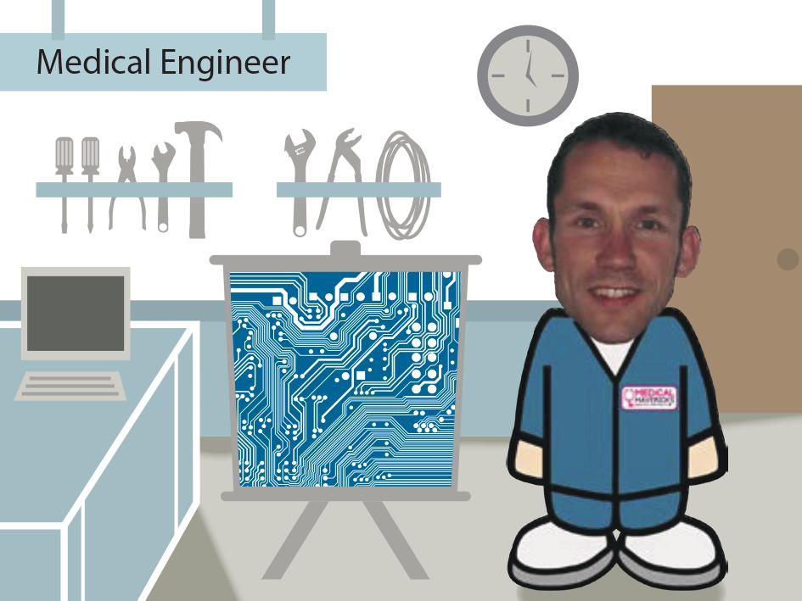

Slide 11
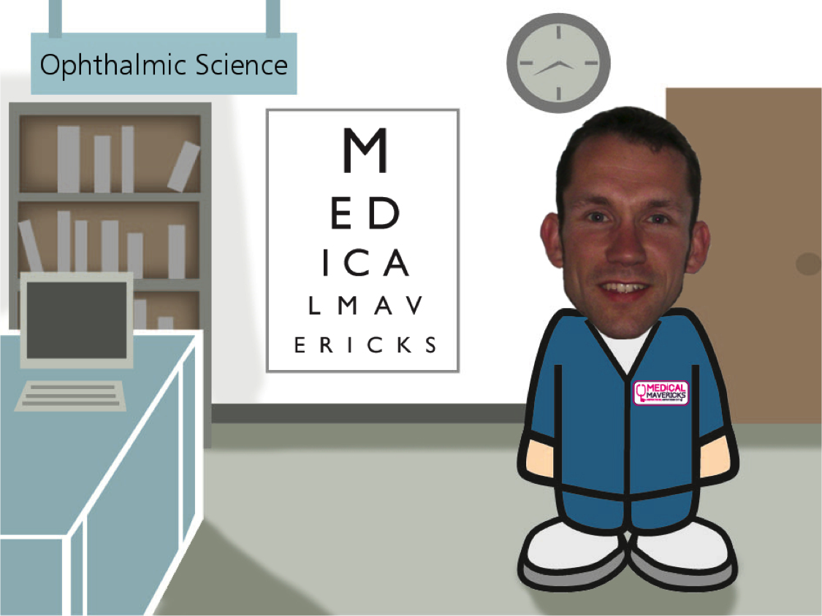

Slide 12
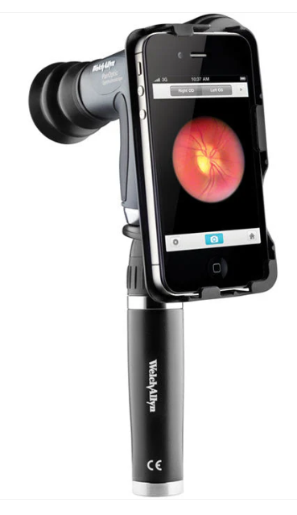

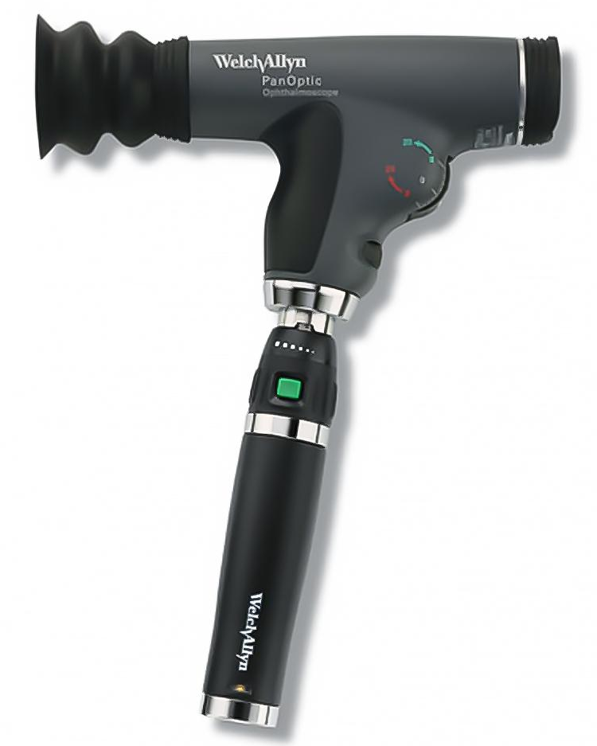
Ophthalmic
Science
Engineering

Slide 13
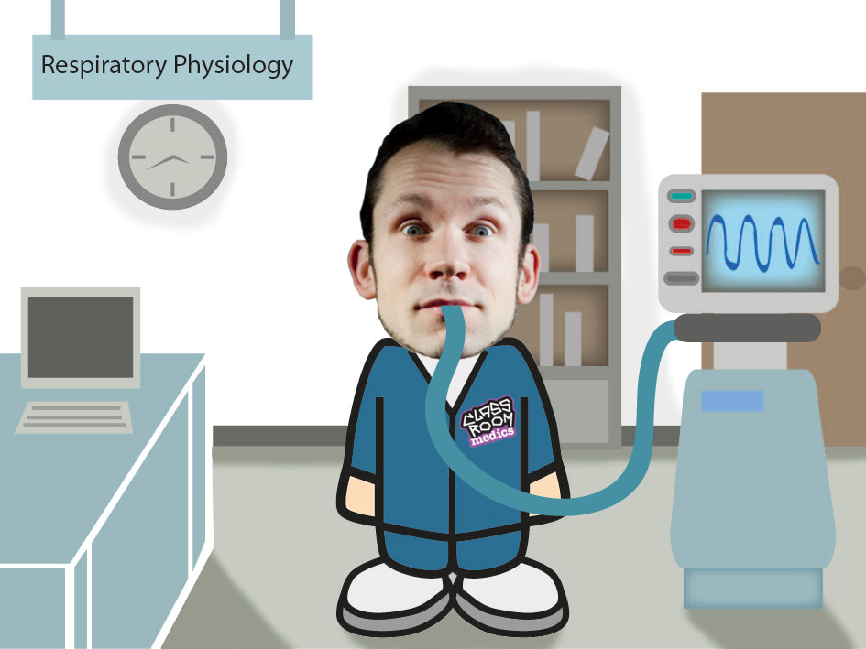

Slide 14
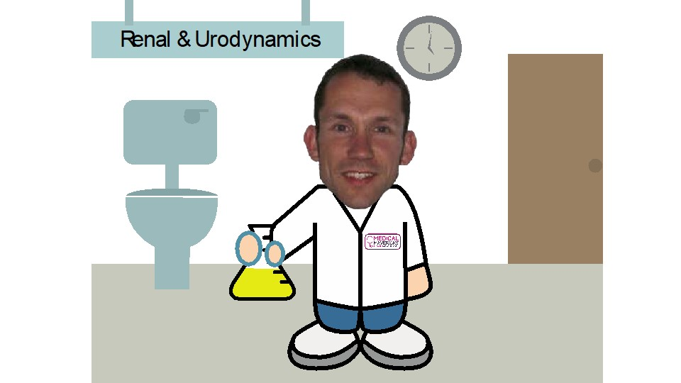

Slide 15


Slide 16
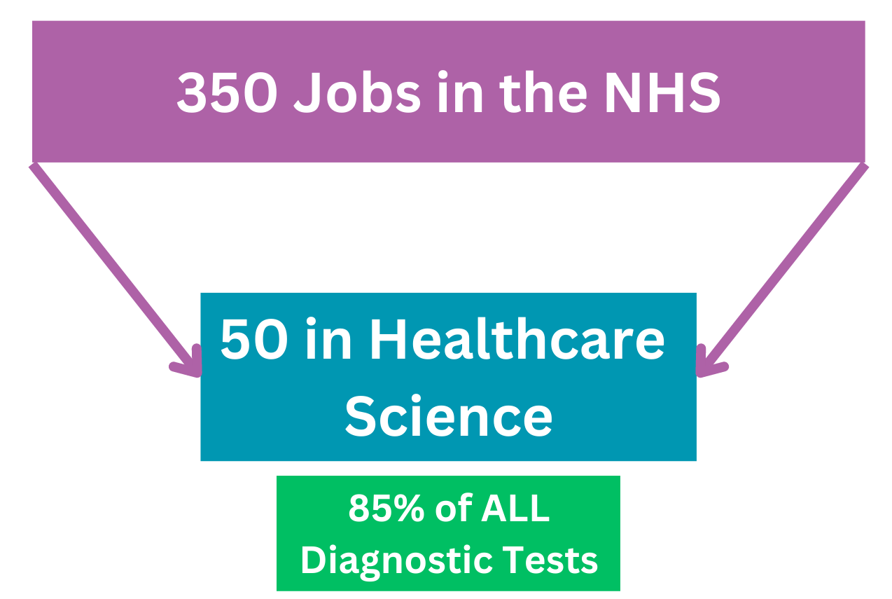

Slide 17
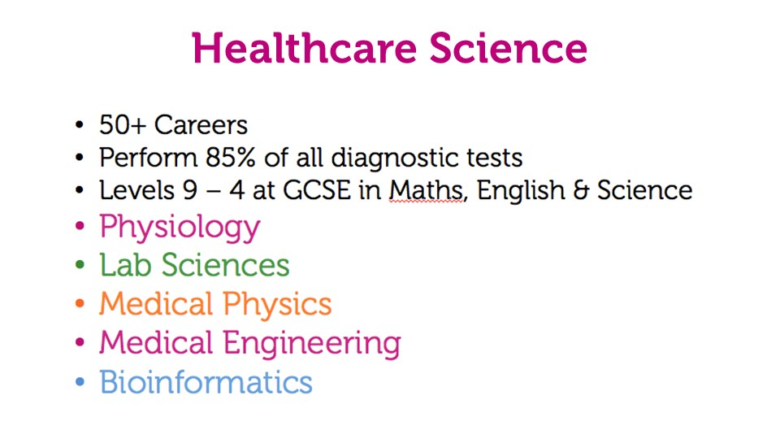

Slide 18
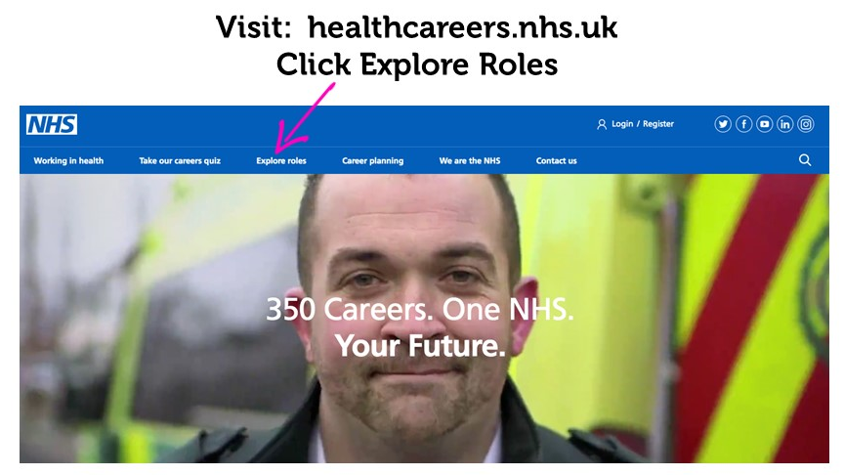
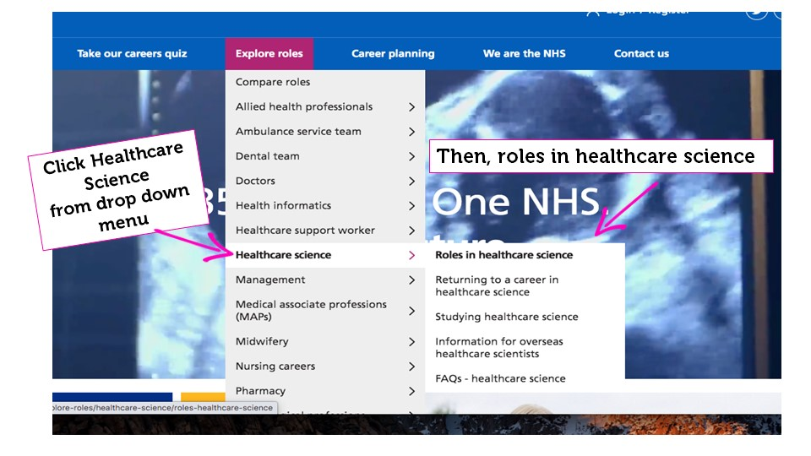
Want to know more?

